Slide 1
LET'S DATE AGAIN
MVP Screen Flow
Complete UI reference for the design team — screen by screen, step by step
21
5
4
3
Screens
Day flow
Types
Intro
Solo user MVP · No login · 5-day streak · Version 1.0 · Prerna, Founder

Slide 2
COMPLETE SCREEN FLOW
21 screens · step-by-step user journey from first open to Day 5
INTRO
I-1
I-2
I-3
Splash
→
Commitment
→
Name Only
DAY 1
D1-1
D1-2
D1-3–9
D1-11
Slider
→
Honest Moment
→
Spark Quiz
→
Type Result
BRIDGE
B1-2
B2-3
B3-4
B4-5
Bridge D1→D2
→
Bridge D2→D3
→
Bridge D3→D4
→
Bridge D4→D5
DAYS 2–5
D2-1
D3-1
D4-1/2
D5-1/2
Mood Candle
→
Snapshot Card
→
Drop Box
→
Review + Invite
Each screen is detailed on the following slides

Slide 3
DESIGN SYSTEM
Colour palette · Typography · Spacing — apply consistently to all 21 screens
#C44569
#1A1A2E
#0E0E1F
#FDF8F5
#F4F0EC
#8A7E78
Rose — CTAs, streaks, accents
Ink — Dark screen bg
Deep Dark — Immersive screens
Cream — App background
Chalk — Input fields
Stone — Secondary text
#FBEAF0
#ED93B1
#1D9E75
#BA7517
#534AB7
#FFFFFF
Rose Light — Card fills
Rose Mid — Labels on dark
Teal — Connected mood
Amber — Grateful mood
Purple — Deep Current type
White — Text on dark
TYPOGRAPHY + SPACING
Playfair Display
Display / Headings
Wt 600 upright · 400–500 italic · Questions, type names, quotes, result screens
DM Sans
Body / UI
Wt 400 regular · 500 medium ONLY · Labels, body, buttons, captions. Never 600+
Design at 390px width · 16px screen padding · 4px base unit · Cards: 14px radius · Buttons: 100px pill · Inputs: 10px radius · No gradients · No drop shadows

Slide 4
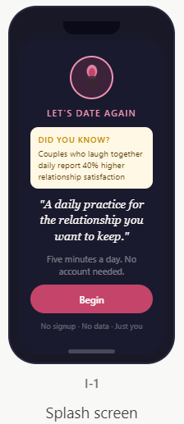
SCREEN I-1
Splash Screen
First thing the user sees. One sentence. One button. Zero friction. Product speaks before brand.
Inclusions
1. Logo
2. DYK
3. Quotes
4. CTA- Begin

Slide 5
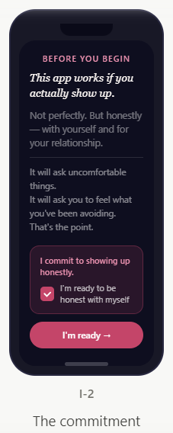
SCREEN I-2
The Commitment
Pre-commitment creates accountability. Users who explicitly commit have higher Day 7 return rates.
Signals a private, serious moment.
Headline: 'This app works if you actually show up.’
Three warning lines below divider — Emotional framing, not legal text.
Commitment card
Checkbox MUST animate — ticks from unchecked to checked on screen load over 300ms. Never statically pre-ticked. This animation is intentional behaviour design.
CTA: 'I'm ready →' — rose pill. Arrow signals forward motion, not just confirmation.

Slide 6
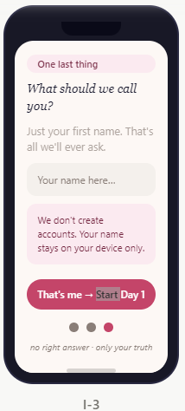
SCREEN I-3
Name Only
The only personal data ever collected. One field, first name only. No email, no password, no account.
Background: Light, warm, open.
Rose-light pill tag: 'One last thing’ —
Headline: 'What should we call you?' — no visible border. Placeholder: 'Your name here…'
Privacy card: rose-light fill. Text: 'We don't create accounts. Your name stays on your device only.'
CTA disabled (50% opacity) until user types 2+ characters. Label: 'That's me → Start Day 1'
3 progress dots bottom-centre. Third (active) = rose, first two = stone.
Keyboard auto-opens on arrival. Input field auto-focused.
Tap → enter Day 1 flow (no transition — direct load of D1-1).

Slide 7
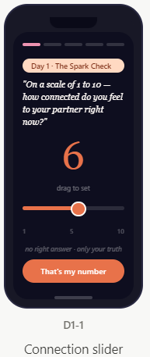
SCREEN D1-1
Connection Slider
Establishes the emotional baseline. Stored as baseline_connection_score — resurfaces Day 3 and Day 5.
Background: #0E0E1F. No nav bar. No back button. Full focus.
5-day progress strip at top: Day 1 pip rose-mid, Days 2–5 at 75% transparency.
Slider defaults to 5 (not 1). Anchoring at midpoint means users move intentionally.
Large number: Playfair/Georgia 56px, rose #C44569. Updates live as user drags.
Track: 6px height. Rose fill to thumb. 15% white opacity right of thumb. Thumb: 24px rose circle, 2.5px white border. 44×44px tap target.
Haptic: UIImpactFeedbackGenerator light (iOS) / HapticFeedbackManager KEYBOARD_TAP (Android) on each integer.
CTA label: 'That's my number' — NOT 'Next'. The wording signals the number matters.
Tap → 0.4s fade → D1-2. The number visually animates from this screen into the large display on D1-2.
STORE: baseline_connection_score + timestamp in local storage.

Slide 8
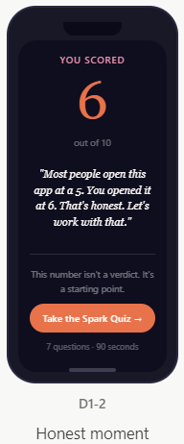
SCREEN D1-2
The Honest Moment
Makes the user feel seen in 60 seconds. Response copy changes based on their exact score. Pre-written — not AI.
Score | Response copy shown on screen (exact wording)
1–3 | "Most people wouldn't admit this. You just did. That takes courage — and it's exactly why you're here. Let's start from honest."
4–5 | "Most people open this app at a 5. You opened it at [N]. That's honest. Let's work with that."
6–7 | "Most people open this app at a 5. You opened it at [N]. You're doing better than you think — and we'll make sure it stays that way."
8–9 | "[N] out of 10. You're here because you want to protect something good. That's the smartest thing a couple can do. Let's keep it that way."
10 | "10. Either things are genuinely perfect — or you're being very kind to yourself. Either way, we'll find out. Let's begin."
Screen is intentionally 4–6 seconds long. Do not rush entry animation. The pause is the experience.

Slide 9
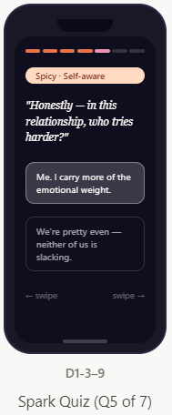
SCREENS D1-3 TO D1-9
Spark Quiz — 7 Questions
7 rapid-fire binary questions. Swipe or tap. Auto-advances 120ms after selection — no confirm button.
Q# | Mood badge | Question — Option A vs Option B
Q1 | Warmth · Day-to-day | You'd rather your partner surprise you with: A heartfelt letter at 2am | B spontaneous trip
Q2 | Honest · Conflict | Arguments start because of: A small things piling up | B one specific thing every time
Q3 | Spicy · Attachment | Partner comes home: A come find you first | B decompress then come find you
Q4 | Deep · Values | Relationship needs most: A more uninterrupted time | B better deeper conversations
Q5 | Spicy · Self-aware | Who tries harder: A me, I carry more emotional weight | B we're pretty even
Q6 | Warm · Vision | In 5 years: A still laughing at same stupid things | B built something we're both proud of
Q7 | The decider | When things get hard: A talk it out even if messy | B give it space, things get clearer
Q7 is the tie-breaker (weighted +3). Store all 7 individual answers — not just the type result. Answers power prompt personalisation from Day 2.

Slide 10
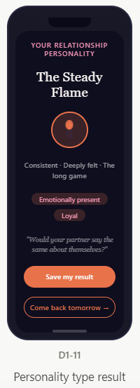
SCREEN D1-11
Personality Type Result
The shareable Day 1 result. 4 possible types — feels like a horoscope the user actually believes.
Type | Sub-label | Growth edge shown at bottom of card
The Steady Flame | Consistent · Deeply felt | You assume they know. They might not. Say it out loud more.
The Electric Spark | Spontaneous · High energy | The spark needs to land somewhere safe. Make sure they feel secure, not just excited.
The Deep Current | Thoughtful · The still water | Your depth can feel like distance. Let them in before you've figured it all out.
The Shifting Tide | Adaptive · Truth-teller | Honesty without tenderness is just criticism. The how matters as much as the what.
Hook line: 'Would your partner say the same about themselves?' — Playfair italic rose-mid. Last thing user reads. Plants the invite hook. Result card exported as 1080×1080px shareable image.

Slide 11
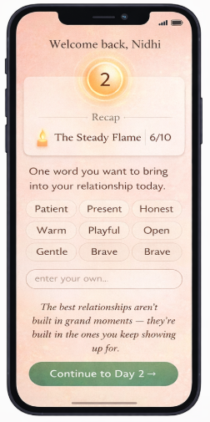
BRIDGE SCREENS D2-1
The Bridge Screen
Appears every day from Day 2 onward. Same 4-zone template — different content each day.
"One word you want to bring to your relationship today."
Single word input. Tap to select from 8 soft options (Patient / Present / Honest / Warm / Playful / Open / Gentle / Brave) or type their own.
This word appears:
As a small pill on the Day 2 mood screen when they open it
Transition | Bridge quote (exact — original to LDA)
D1→D2 | "The best relationships aren't built in grand moments — they're built in the ones you keep showing up for."
D2→D3 | "Noticing what's good is not the same as ignoring what's hard. It's choosing where to look first."
D3→D4 | "The things left unsaid don't disappear. They just find other ways to come out."
D4→D5 | "A relationship that can hold honesty can hold anything."

Slide 12
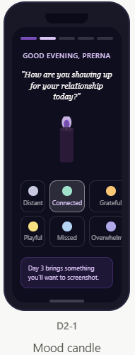
SCREEN D2-2
Mood Candle Screen
8 relationship-specific moods. Candle changes colour on selection — the most memorable UI detail in the app.
Mood | Flame hex | Flame behaviour | Segment
Distant | #C8C8E0 | Slow, nearly still | Sadness
Connected | #9FE1CB | Steady, full, unhurried | Happiness
Grateful | #FAC775 | Round, warm, full | Happiness
Frustrated | #F09595 | Tall, agitated, fast flicker | Saturated
Playful | #FAE080 | Dancing, irregular | Happiness
Missed | #B5D4F4 | Small, still, lonely | Sadness
Overwhelmed | #AFA9EC | Bends sideways, erratic | Sadness
Loved | #C44569 | Full, tall, confident, no flicker | Happiness
Right after mood selection and before the follow-up question appears, insert this single prompt as a full-screen moment:
"Before anything else — name one thing about your partner that made you feel something good recently. It can be tiny."
Single text field. Soft placeholder: "Even the smallest thing counts." 10–40 characters max. No pressure for length.
This immediately becomes a card — their words, in Playfair italic, on a lavender background. Auto-saved to their journal. Takes 20 seconds.

Slide 13
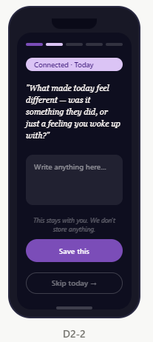
SCREEN D2-3
Follow-Up Question
One question based on the mood's emotional segment. Three question pools rotating daily.
Segment | Moods | Question pool — 3 options, rotated daily
Happiness | Connected, Grateful, Playful, Loved | (1) What made today feel different — something they did, or you noticed? (2) If you could bottle this feeling, what would the label say? (3) What about your relationship right now don't you want to forget?
Sadness | Distant, Missed, Overwhelmed | (1) Is the heaviness between you two, or outside getting in the way? (2) What would feel better by tomorrow — conversation, space, or just being seen? (3) If your partner could read one sentence about how you feel right now, what would it say?
Saturated | Frustrated only | Adapts to Day 1 Q2: If Q2=A (small things): 'What's the specific small thing that tipped it today?' · If Q2=B (one big thing): 'Is this the same thing again — or something new?' · Default: 'Frustration means something matters. What's underneath this?'
Privacy note ('This stays with you. We don't store anything') must be visible without scrolling. Skip CTA must always be present — never remove it.

Slide 15
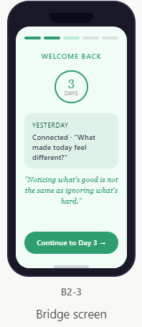
SCREENS D3-1
The Bridge Screen
Tap to select from 8 soft options (Patient /Present / Honest / Warm / Playful / Open / Gentle / Brave) or type their own.​
Appears every day from Day 2 onward. Same 4-zone template — different content each day
Transition | Bridge quote (exact — original to LDA)
D1→D2 | "The best relationships aren't built in grand moments — they're built in the ones you keep showing up for."
D2→D3 | "Noticing what's good is not the same as ignoring what's hard. It's choosing where to look first."
D3→D4 | "The things left unsaid don't disappear. They just find other ways to come out."
D4→D5 | "A relationship that can hold honesty can hold anything."

Slide 16
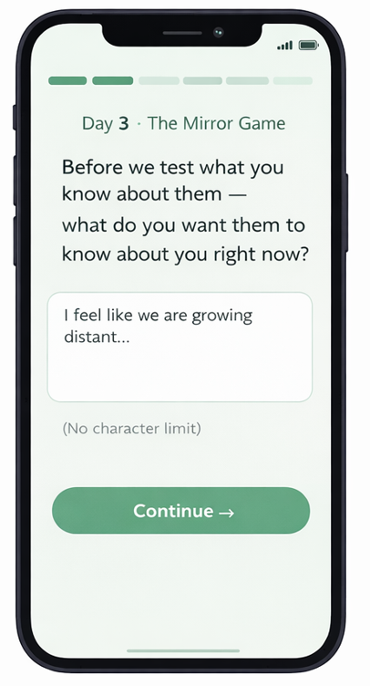
SCREENS D3-1
Input Screen
Appears every day from Day 2 onward. Same 4-zone template — different content each day
A single full-screen prompt before the T/F questions begin:​
"Before we test what you know about them — what do you want them to know about you right now?"​
One sentence. Open text. No character limit. Becomes a shareable card on mint background: their words + "From [Name], Day 3" in small text.

Slide 17
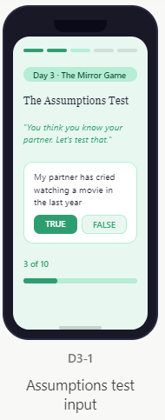
SCREENS D3-3
The Mirror Game
The Compatibility Challenge. 10 True/False statements about their partner. No results yet shown.
•Header: 'The Assumptions Test' — bold, confident. Sub-line: 'You think you know your partner. Let's test that.'
•10 rapid True/False statements. One question fills most of the screen. User scrolls through. TRUE button = mint filled. FALSE = ghost outlined.
•Progress bar at bottom — fills mint green as each statement is answered.
•NO results shown on this screen. All 10 answers are collected first before any reveal.
# | Statement (all 10 — exact wording)
1 | My partner has cried watching a movie in the last year
2 | My partner has thought about quitting their job recently
3 | My partner feels most loved when I give them time, not gifts
4 | My partner has a dream they haven't told me about yet
5 | My partner worries about money more than they let on
6 | My partner would rather stay in than go out on most Fridays
7 | My partner has a friendship they wish they'd kept up better
8 | My partner feels prouder of themselves in our relationship than before it
9 | My partner finds it easier to apologise than I do
10 | My partner thinks about our future together more than they say out loud

Slide 18
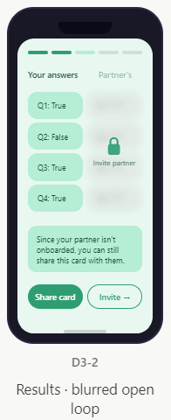
SCREENS D3-3
Day 3 · Mirror Game Results — The Open Loop
Most powerful conversion screen. Left shows user's answers. Right is blurred. Only partner can complete it.
•This is the strongest conversion moment in the entire app.
•After all 10 answered: Show LEFT column = user's answers visible. RIGHT column = blurred/frosted (partner's side, empty).
•Bottom banner: 'Since your partner isn't onboarded yet, you can still share this card with them.' — Two CTAs: 'Share card' (export image) and 'Invite partner' (WhatsApp deep link).
•Screenshot / Save icon at top right of screen — always visible. Tapping exports the card as an image.
•The open loop: user has answered 10 questions but cannot see if they were right. The ONLY way to resolve the tension is to invite their partner. The invite link writes itself.
•Why Day 3 is critical: This is where users either drop or deeply invest. The game makes them feel the gap between assumption and truth — that gap is your entire product value proposition made visceral.

Slide 19
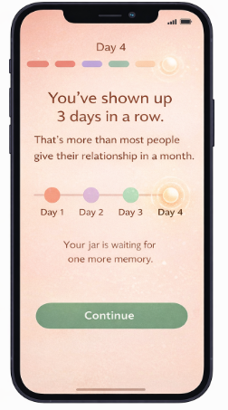
SCREENS D4-1
Day 4 · The Bridge Screen
Drop one memory. Visual jar fills up. By Day 5, the jar is full — proof of 5 days of showing up
On the bridge screen entering Day 4, instead of just yesterday's recap — show a small visual:​
"You've shown up 3 days in a row. That's morethan most people give their relationship in amonth."​
Below it: a mini timeline showing Days 1–3 ascoloured dots (coral, lavender, mint) with Day4 as a pulsing empty dot waiting to be filled.Small text: "Your jar is waiting for one morememory."​
The pulsing empty dot is the hook. It creates aspecific visual anticipation — not vague("come back tomorrow") but precise ("there isone empty dot and you can fill it today").

Slide 20
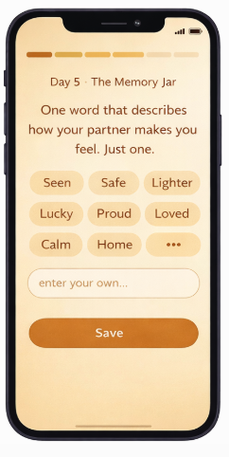
SCREENS D4-1
Day 4 · The Memory Jar
"One word that describes how your partner makes you feel. Justone."​
Eight soft word options appear as tappable pills on the amberbackground: Seen / Safe / Lighter / Lucky / Proud / Loved / Calm/ Home.​
They can tap one or type their own. The word appears insidetheir memory jar as a golden glow — visible when they open thejar view. It is the only personalised label inside the jar. On Day 5'sjar reveal, this word floats up as the jar opens.

Slide 21
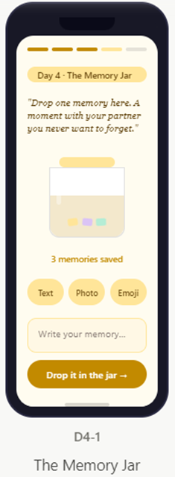
SCREENS D4-1
Day 4 · The Memory Jar
Drop one memory. Visual jar fills up. By Day 5, the jar is full — proof of 5 days of showing up
•Day 4 accent: #C28A00 (golden amber). Background warm cream #FFFCF0.
•Header prompt: 'Drop one memory here. A moment with your partner you never want to forget.'
•Three input types: Text / Photo / Emoji + date. User picks one. No pressure to write long — even an emoji + date counts.
•The JAR: Beautiful illustrated glass jar on screen. Each day a paper note animates dropping in. By Day 5 = 5 notes, jar is full. This runs as a persistent visual metaphor across all 5 days — shown on the bridge screens and the Day 5 reveal.
•Counter below jar: '[N] memories saved'. Starts at 0, increments each day after a memory is dropped.
•'Drop it in the jar →' CTA — amber. On tap: a paper note animates flying into the jar (300ms arc animation). Then the jar gently shakes once.
•The jar fills to 55% by Day 4, completing on Day 5. Design shows 60% filled water/golden light level on Day 4.
•All memories stored on-device only. 'Your memories are private. Never shared, never seen by us.'

Slide 22
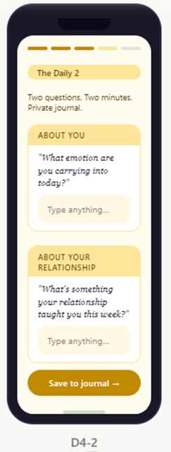
SCREENS D4-1
Day 4 · The Daily 2
Two micro-journaling questions. One personal. One relational. By end of 7 days, a private journal built without realising it
•Two questions, always paired, always in this order:
•Q1 — About you: 'What emotion are you carrying into today?' — labelled with amber tag 'ABOUT YOU'
•Q2 — About relationship: 'What's something your relationship taught you this week?' — labelled 'ABOUT YOUR RELATIONSHIP'
•Both are open text. No character limit. No prompt suggestions. Just blank space.
•CTA: 'Save to journal →' — saves to the private on-device journal. After Day 5, journal is accessible from the Jar screen.
•Key design insight: These are journaling prompts disguised as micro-interactions. Users are building a private relationship journal without realising it — the journal is the product's deepest retention hook.
•All journal entries stored on-device only. No cloud sync in MVP. 'Your journal is yours alone.'
•Daily 2 format: always visible after the memory jar drop on Day 4 and Day 5+. Repeats daily after Day 5 as the ongoing habit loop.

Slide 23
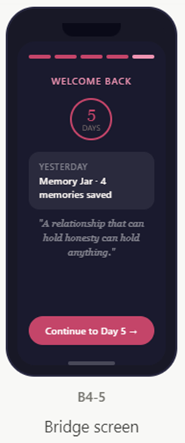
SCREENS D5-1 + D5-2
5-Day· The Bridge Screen

Slide 24
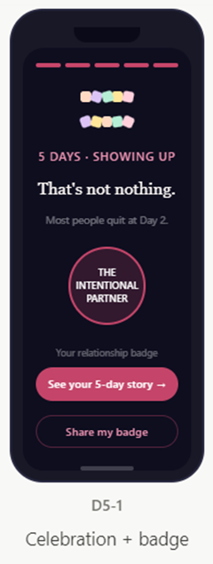
SCREENS D5-1 + D5-2
Day 5 · The Streak Celebration
Full-screen celebration. Confetti. Badge. This screen must feel like a gift.
•Progress strip: all 5 pips rose-filled. First time user sees a complete strip — design this moment with care.
•Full-screen confetti animation on entry. Rose + day colour confetti pieces raining down. 2 seconds, then settles. This is mandatory — 'Don't let it be silent.'
•'5 days of showing up for your relationship. That's not nothing — most people quit at Day 2.'
•Three badge options (assign based on personality type + quiz answers): 'The Intentional Partner' / 'The Curious Lover' / 'The Relationship Builder'. Badge shown as a glowing rose circle with bold Playfair text inside.
•CTA: 'See your 5-day story →' leads to the Report Card screen.
•Secondary CTA (ghost): 'Share my badge' — exports as 1080×1080px image for Instagram/WhatsApp.

Slide 25
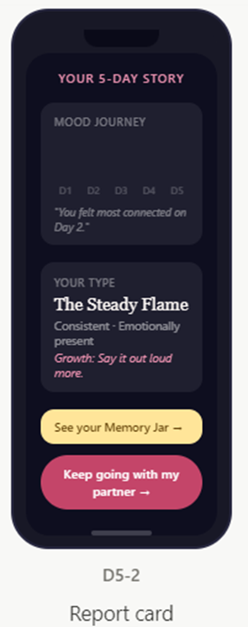
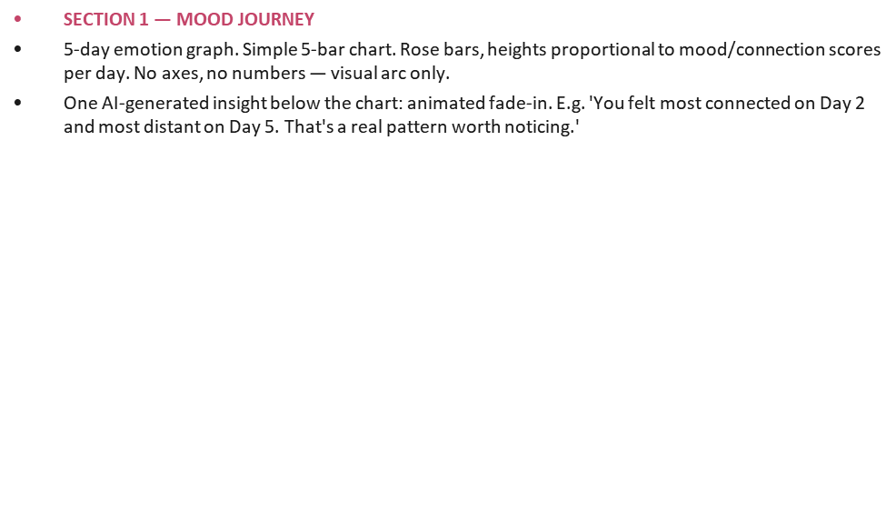
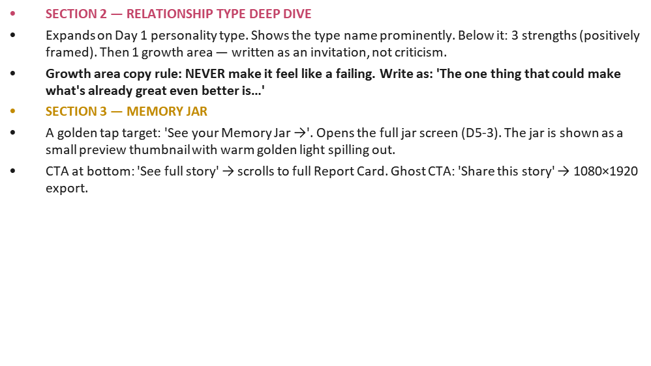
SCREENS D5-1 + D5-2
Day 5 · Relationship Report Card
The 5-day story visualised. Mood journey graph. Type deep dive. Designed to feel like a love letter, not an evaluation.

Slide 26
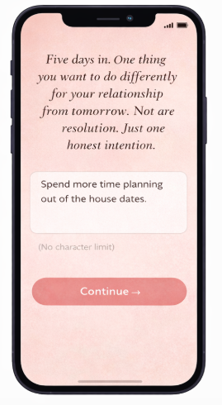
SCREENS D5-1 + D5-2
Day 5 · Relationship Report Card
After the report card — before the jar reveal — onefull-screen prompt:​
"Five days in. One thing you want to do differentlyfor your relationship from tomorrow. Not aresolution. Just one honest intention."​
Open text field. Becomes the last page of theirprivate journal. Appears on the shareable Day 5card alongside their badge. Playfair italic, rosebackground, their words.

Slide 27
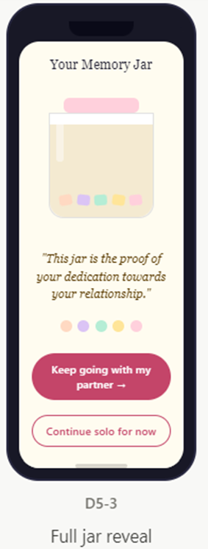
SCREENS D5-1 + D5-2
Day 5 · THE MEMORY JAR SYSTEM
A visual metaphor that runs across all 5 days. One paper note per day. Full jar = completed streak

Slide 28
INTERACTIONS + ANIMATIONS
Reference for all transitions, micro-interactions, and required screen states
Interaction | When | Specification
Fade from black | App open, bridge entry, day results | 400ms fade in from #0E0E1F
Slide up | Follow-up questions, CTAs on bridge | 12px up + fade in, 250ms, ease-out
Scale compress | Quiz option after selection | scale 0.95 + opacity 0.5, 150ms → next Q slides up 250ms
Count-up | Streak counter on bridge screen | Number ticks up from prev value, 300ms
Candle colour shift | Mood selection on D2-1 | SVG fill transition over 400ms. Flame size/speed also shifts per mood.
Stagger reveal | Mood chips, trait pills | Each element 50ms delay after previous
Progress bar fill | Snapshot card on D3-1 | Animate from 0 to final over 600ms on screen entry
Checkbox animate | I-2 on screen load | Unchecked → checked 300ms. Never pre-ticked statically.
Streak ring pulse | Bridge screen on increment | scale 1.0 → 1.1 → 1.0, 300ms
Haptic feedback | Slider integers, quiz selection | iOS: UIImpactFeedbackGenerator light · Android: HapticFeedbackConstants.KEYBOARD_TAP
REQUIRED STATES — design all of these for every input screen:
Empty Before interacting Active/Filled While interacting Completed After saving Loading AI reframe only Disabled CTA at 50% opacity before condition met

Slide 29
NOT IN THIS MVP
Do not design screens for any of the following. Answer is: Phase 2.
Partner view or couple mode — any screen involving a second user
Login, registration, email verification, account creation, password
Subscription or payment screens (Razorpay — Phase 2)
Relationship health dashboard or analytics charts
In-app messaging or couple chat (LDA is NOT a messaging app)
Expert therapist sessions or guided programs
Social features or community inside the app
Push notification settings page
User settings page or profile page
Voice notes or audio messages
Conflict resolution module
Every time a feature from this list comes up during design — document it and move on. This MVP has one job: prove that a user will open the app for 5 consecutive days and feel it was worth their time.

